Slide 1
Two-Dimensional Geometric Transformations:
With the procedures for displaying output primitives and their attributes, we can create variety of pictures and graphs. In many applications, there is also a need for altering or manipulating displays. Design applications and facility layouts are created by arranging the orientations and sizes of the component parts of the scene. And animations are produced by moving the "camera" or the objects in a scene along animation paths. Changes in orientation, size, and shape are accomplished with geometric transformations that alter the coordinate descriptions of objects.
The basic geometric transformations are translation, rotation, and scaling. Other transformations that are often applied to objects include reflection and shear. We first discuss methods for performing geometric transformations and then consider how transformation functions can be incorporated into graphics packages.

Slide 2
Two-Dimensional Geometric Transformations:
BASIC TRANSFORMATIONS:
Translation:
A translation is applied to an object by repositioning it along a straight-line path from one coordinate location to another. We translate a two-dimensional point by adding translation distances, t_{x} and t_{y} , to the original coordinate position (x, y) to move the point to a new position ( x ' , y') (Fig. 5-1).
x' = x + t_{x}, y' = y + t_{y} …….. (5.1)
The translation distance pair (t_{x}, t_{y}) is called a translation vector or shift vector. We can express the translation equations 5.1 as a single matrix equation by using column vectors to represent coordinate positions and the translation vector:

Slide 3
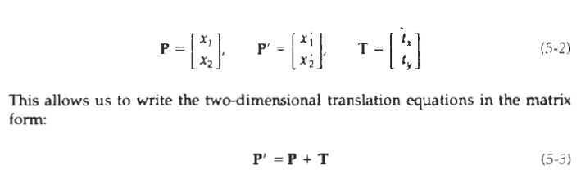
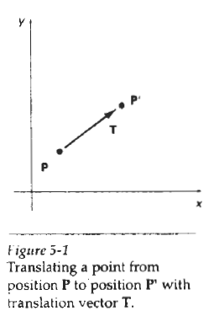
Two-Dimensional Geometric Transformations:
Sometimes matrix-transformation equations are expressed in terms of coordinate row vectors instead of column vectors. In this case, we would write the matrix representations as P = [x y] and T = [t_{x} t_{y}] Since the column-vector representation for a point is standard mathematical notation, and since many graphics packages, for example, GKS and PHIGS, also use the column-vector representation, we will follow this convention.

Slide 4
Two-Dimensional Geometric Transformations:
Translation is a rigid-body transformation that moves objects without deformation. That is, every point on the object is translated by the same amount. A straight Line segment is translated by applying the transformation equation 5-3 to each of the line endpoints and redrawing the line between the new endpoint positions. Polygons are translated by adding the translation vector to the coordinate position of each vertex and regenerating the polygon using the new set of vertex coordinates and the current attribute settings.
Figure 5-2 illustrates the application of a specified translation vector to move an object from one position to another.
Similar methods are used to translate curved objects. To change the position of a circle or ellipse, we translate the center coordinates and redraw the figure in the new location. We translate other curves (for example, splines) by displacing the coordinate positions defining the objects, then we reconstruct the curve paths using the translated coordinate points.

Slide 5
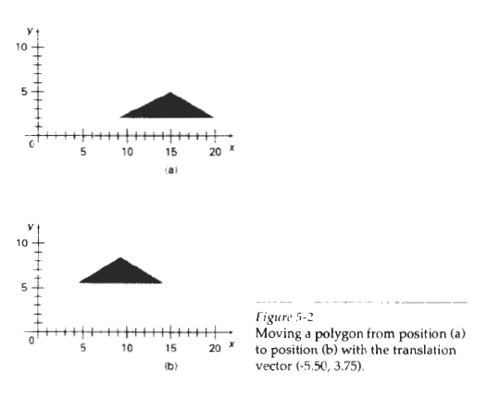
Two-Dimensional Geometric Transformations:

Slide 6
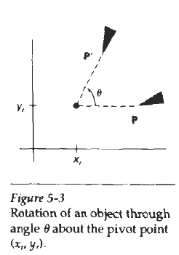
Two-Dimensional Geometric Transformations:
Rotation:
A two-dimensional rotation is applied to an object by repositioning it along a circular path in the xy plane. To generate a rotation, we specify a rotation angle θ and the position (x_{r}, y_{r}) of the rotation point (or pivot point) about which the object is to be rotated (Fig. 5-3). Positive values for the rotation angle define counterclockwise rotations about the pivot point, as in Fig. 5-3, and negative values rotate objects in the clockwise direction. This transformation can also be described as a rotation about a rotation axis that is perpendicular to the xy plane and passes through the pivot point.

Slide 7
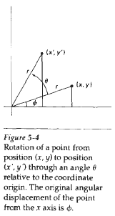
Two-Dimensional Geometric Transformations:
We first determine the transformation equations for rotation of a point position P when the pivot point is at the coordinate origin. The angular and coordinate relationships of the original and transformed point positions are shown in Fig. 5-4. In this figure, r is the constant distance of the point from the origin, angle Φ is the original angular position of the point from the horizontal, and θ is the rotation angle. Using standard trigonometric identities, we can express the transformed coordinates in terms of angles θ and Φ as

Slide 8
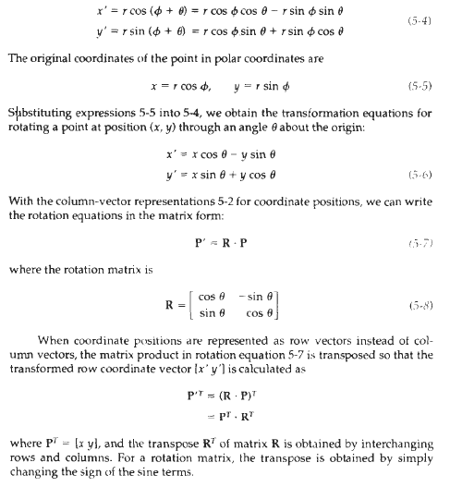
Two-Dimensional Geometric Transformations:

Slide 9
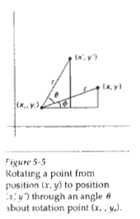

Two-Dimensional Geometric Transformations:
Rotation of a point about an arbitrary pivot position is illustrated in Fig. 5-5. Using the trigonometric relationships in this figure, we can generalize Eqs. 5-6 to obtain the transformation equations for rotation of a point about any specified rotation position (x_{r}, y_{r}):
These general rotation equations differ from Eqs. 5-6 by the inclusion of additive terms, as well as the multiplicative factors on the coordinate values. Thus, the matrix expression 5-7 could be modified to include pivot coordinates by matrix addition of a column vector whose elements contain the additive (translational) terms in Eqs. 5-9. There are better ways, however, to formulate such matrix equations, and we discuss in Section 5-2 a more consistent scheme for representing the transformation equations.

Slide 10
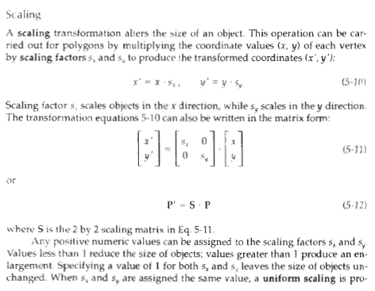
Two-Dimensional Geometric Transformations:

Slide 11
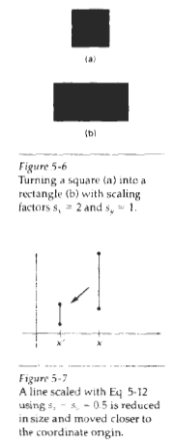
Two-Dimensional Geometric Transformations:
produced that maintains relative object proportions. Unequal values for s_{x} and s_{y} result in a differential scaling that is often used in design applications, where pictures are constructed from a few basic shapes that can be adjusted by scaling and positioning transformations (Fig. 5-6).
Objects transformed with Eq. 5-11 are both scaled and repositioned. Scaling factors with values less than 1 move objects closer to the coordinate origin, while values greater than 1 move coordinate positions farther from the origin. Figure 5-7 illustrates scaling a line by assigning the value 0.5 to both s_{x} and s_{y} in Eq. 5-11. Both the line length and the distance from the origin are reduced by a factor of 1 /2.

Slide 12
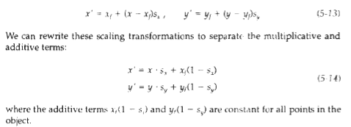
Two-Dimensional Geometric Transformations:
We can control the location of a scaled object by choosing a position, called the fixed point, that is to remain unchanged after the scaling transformation. Coordinates for the fixed point (x_{f}, y_{f}) can be chosen as one of the vertices, the object centroid, or any other position (Fig. 5-8). A polygon is then scaled relative to the fixed point by scaling the distance from each vertex to the fixed point. For a vertex with coordinates (x, y), the scaled coordinates ( x ' , y ') are calculated as

Slide 13
Two-Dimensional Geometric Transformations:
Including coordinates for a fixed point in the scaling equations is similar to including coordinates for a pivot point in the rotation equations. We can set up a column vector whose elements are the constant terms in Eqs. 5-14, then we add this column vector to the product S * P in Eq. 5-12.
Polygons are scaled by applying transformations 5.14 to each vertex and then regenerating the polygon using the transformed vertices. Other objects are scaled by applying the scaling transformation equations to the parameters defining the objects. An ellipse in standard position is resized by scaling the semimajor and semiminor axes and redrawing the ellipse about the designated center coordinates.
Uniform scaling of a circle is done by simply adjusting the radius. Then we redisplay the circle about the center coordinates using the transformed radius.

Slide 14
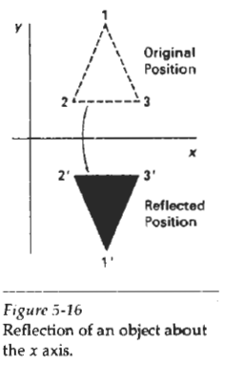
Two-Dimensional Geometric Transformations:
Reflection :
A reflection is a transformation that produces a mirror image of an object. The mirror image for a two-dimensional reflection is generated relative to an axis of reflection by rotating the object 180º about the reflection axis. We can choose an axis of reflection in the xy plane or perpendicular to the xy plane. When the reflection axis is a line in the xy plane, the rotation path about this axis is in a plane perpendicular to the xy plane. For reflection axes that are perpendicular to the xy plane, the rotation path is in the xy plane. Following are examples of some common reflections.

Slide 15
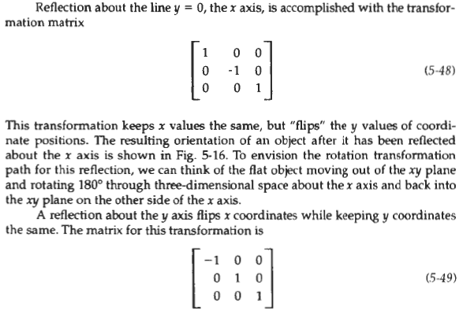
Two-Dimensional Geometric Transformations:

Slide 16
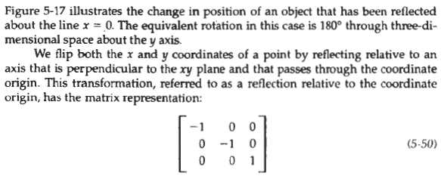
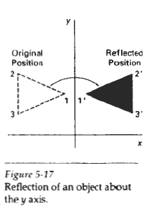
Two-Dimensional Geometric Transformations:

